Slide 1
BUSQOM 1080: Data Analysis for Business
Fall 2020
Lecture 1 (8/20)
Professor: Michael Hamilton

Slide 2
Outline for today
I will introduce the logistics of the course. [10 Mins]
We’ll look at the Canvas webpage together. [5 Mins]
We’ll break out into rooms for short introductions. [5 Mins]
Lecture: What is Business Analytics? [~30 Mins]
Breakout into rooms for Group Activities [20 Mins]

Slide 3
Course Logistics
All materials for this course will be posted on Canvas before the designed class time. This class has been designed so it can be taken fully asynchronously.
Please check two days in advance for Powerpoints, Lectures, Readings, and Discussions threads.
At the designated class time we will meet over Zoom to discuss course material, solve problems, do guided Q+A and more! Zoom sessions will be recorded and uploaded.
Office Hours: 1-4pm on Wednesday over Zoom
(or by appointment)
We’re going to use the programming language R is this course
Books (on Canvas):
Business Analytics Using R - A Practical Approach
R for Marketing Research and Analytics
R for Data Science (Online @ https://r4ds.had.co.nz/)

Slide 4
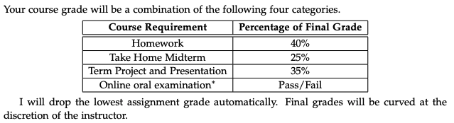
Course Logistics II
Syllabus is posted on the Canvas!
Grading:
For students taking this course in a different time zone, special accommodations will be made for the final project. More on this after the midterm.

Slide 5
Course Logistics III
Syllabus is posted on the Canvas!
Contacting me
The best way to reach me is over email @ mhamilton@katz.pitt.edu
Please allow 24 hours for me to respond
Before emailing, please consider asking your question in the appropriate discussion thread on Canvas (see the discussion tab).
Email etiquette: I remember being stressed out as a student trying to properly email my instructors. For this class, best practices for emailing me are:
Include an informative subject line starting like “[BUSQOM 1080] Subject Here… ”
Begin your email with “Hello Professor Hamilton, …“
Don’t worry too much about crafting perfect emails, I’m here to help.
This course will be fully online. As of now I have no plans to transition this course to in person or flex variants.

Slide 6
About the Software: Programming in R
R is a free, open source programming language that is compatible with any operating system and widely used in academia & industry.
Extremely marketable skill, but challenging to learn on your own. [Poll]
Assignment 1 is posted! Due next Friday at 11:59 pm
Download and install R and Rstudio, complete Lesson 1 in Swirl: R Programming (instructions for downloading in second lecture).
We will spend the next few classes introducing R and it’s functionalities.
I will provide detailed step-by-step instructions for each topic, assuming no prior background with programming.
Advice: “Don’t be intimidated by the software”

Slide 7
Lecture: What is Business Analytics?

Slide 8
(Mostly) Interchangeable Terms
1. Data Analytics : Analysis of data in order to understand it and see how to use the knowledge hidden within it.
Example: Analysis of the data related to purchase behavior among various classes of travelers
2. Business Analytics : Application of data analytics to business.
Example: Offering specific discounts to different classes of travelers based on the amount of business they offer or have the potential to offer.

Slide 9
(Mostly) Interchangeable Terms
3. Data Science : an interdisciplinary field (e.g., statistics, mathematics, and computer programming) that derives knowledge from data and applies it for predictive or other purposes.
Example: determining factors related to the price customers are willing to pay for travel using statistics (e.g., p-values)
4. Big Data Analytics : analysis of huge amounts of data or the analysis of difficult-to-crack problems.
Characteristics of big data: volume, velocity, & variety
The variability and complexity of data may also constitute “big data”
Outside the scope of this course!

Slide 10
Three Aspects of Business Analytics
Identifying business problems that you want to (and are able to!) answer using data.
Hands-on data analysis (statistical, computer science and data modeling skills) to derive insights.
Understand and communicate answers based on analysis.

Slide 11
Three Types of Analytics
Descriptive Analytics : Use statistics/machine learning/data mining to classify, categorize, or describe data.
Example: Categorize employees who were underpaid for a class-action lawsuit into groups
Example: Classify defective products and describe their characteristics
Predictive Analytics : Use statistics/machine learning/data mining to predict future outcomes or behaviors.
Example: Predict the gross box office earnings of an upcoming movie
Example: Predict which customers are going to cancel current service (e.g., cable or internet services)
Prescriptive Analytics : Use optimization/simulation to make recommendations or prescriptions.
Example: Optimizing the efficiency of UPS’s pickup and delivery services

Slide 12
Analytics Industry Council: What are hiring managers interested in?
Way of thinking and ability to apply analytics
Given some data, what questions can you answer/what problems can you solve?
If you have a research question or specific problem, how might you collect data? (Be inventive; make use of latest technology)
Software/programming skills (e.g., R or Python)
Ability of interpret results for a general audience without statistical jargon

Slide 13
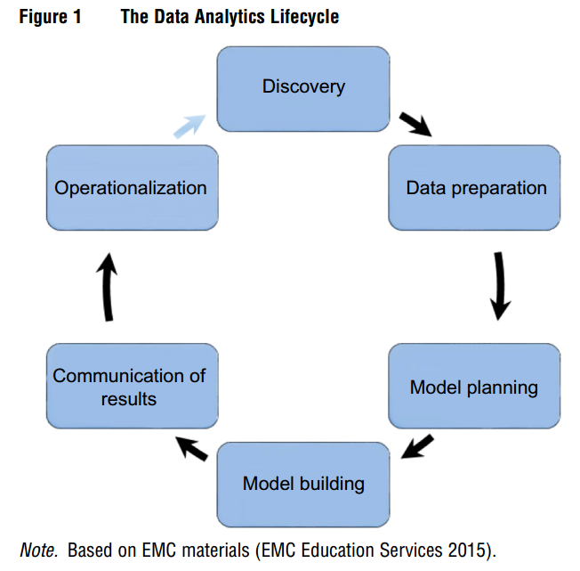
The Data Analytics Life Cycle
Learn about the business problem & assess the data
Collect and prepare data
Preliminary analysis and determining possible models
Implement and fine tune model
Assess business value and report key findings
Implementation of results
Repeat

Slide 14
Life Cycle of a Business Analysis Project

Slide 15
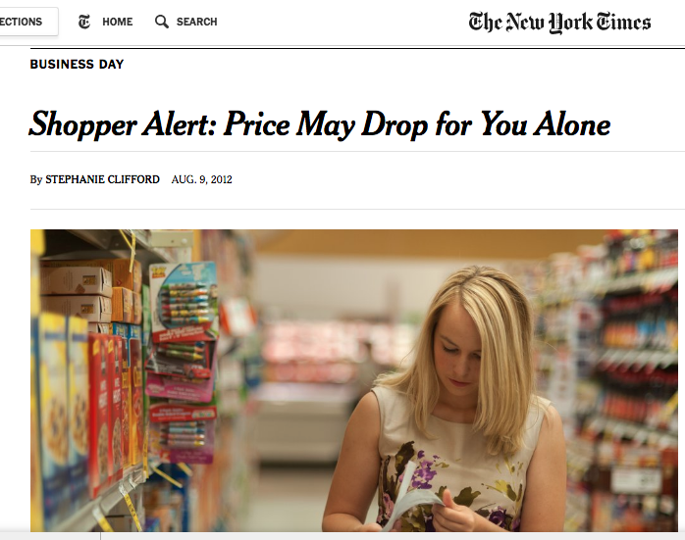
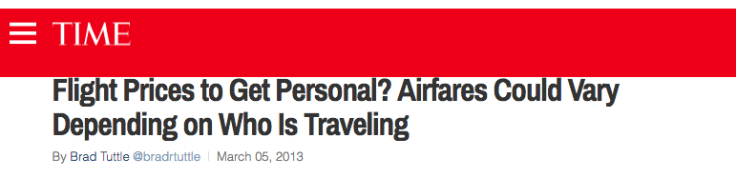
Examples of Analytics at Work
Targeted advertisements/coupons (Examples: Airlines, Grocery)

Slide 16
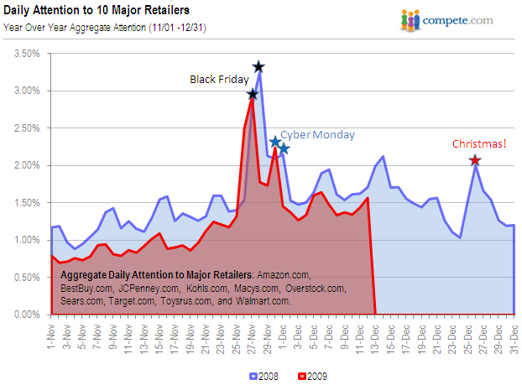
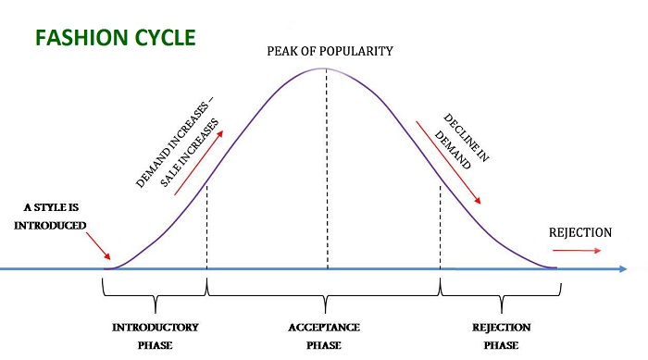
Examples of Analytics at Work
Forecasting demand (Examples: Zara, Amazon)

Slide 17
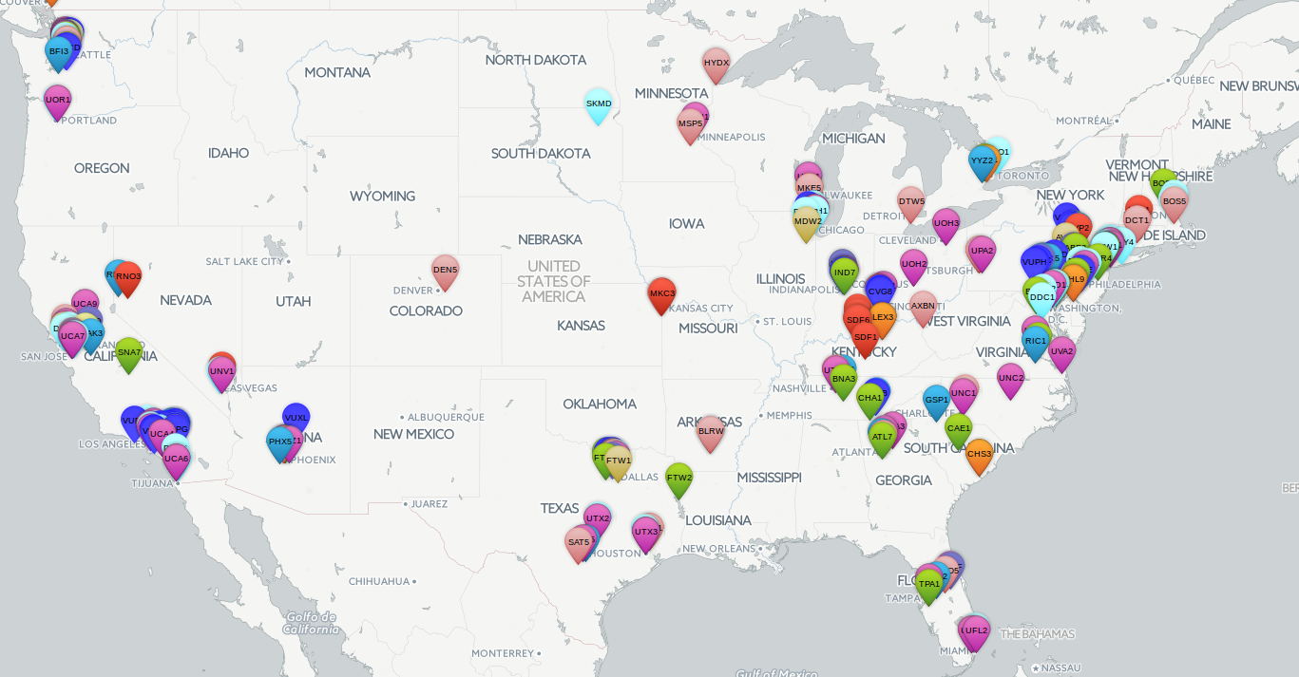
Amazon and Analytics
Business Question: Where should Amazon open warehouses?
Data:
Location of warehouses
Historical Demand

Slide 18
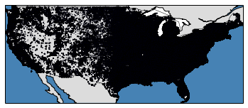
Amazon and Analytics
Business Question: Where should Amazon open warehouses?
Data:
Location of warehouses
Historical Demand

Slide 19
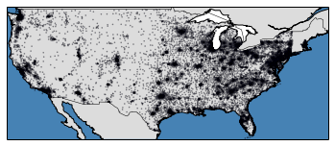
Amazon and Analytics
Business Question: Where should Amazon open warehouses?
Data:
Location of warehouses
Historical Demand
Process the data (clustering)

Slide 20
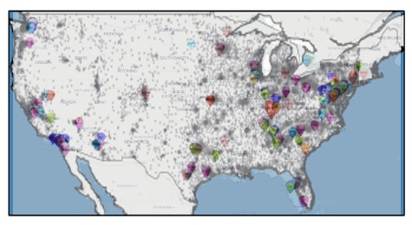
Amazon and Analytics
Business Question: Where should Amazon open warehouses?
Data:
Location of warehouses
Historical Demand
Process the data (clustering)
Compare

Slide 21
Amazon and Analytics
Business Question: Where should Amazon open warehouses?
Data:
Location of warehouses
Historical Demand
Process the data (clustering)
Compare
Analyze and optimize

Slide 22
Amazon and Analytics
Business Question: Where should Amazon open warehouses?
Data:
Location of warehouses
Historical Demand
Process the data (clustering)
Compare
Analyze
Validate (via simulation)

